Slide 1
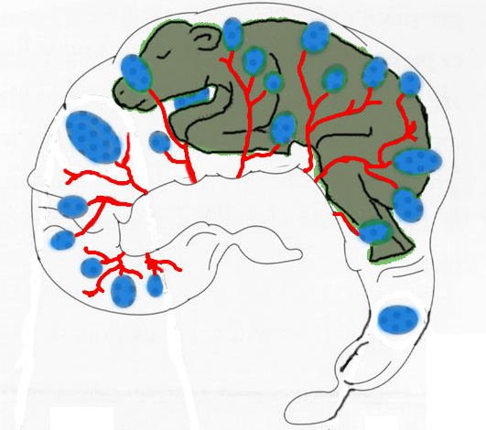
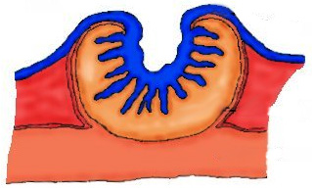
Cotelydonary Placenta
Cow
Convex
Ewe
Cotelydon
Concave
Caruncle
70 - 120
90 - 100
Endometrium

Slide 2
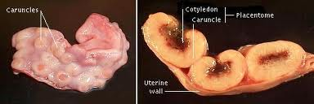

Slide 3
Diffuse Placenta
Pig
Horse
Microcotyledons

Slide 4
Zonary Placenta (bitch, queen)

Slide 5
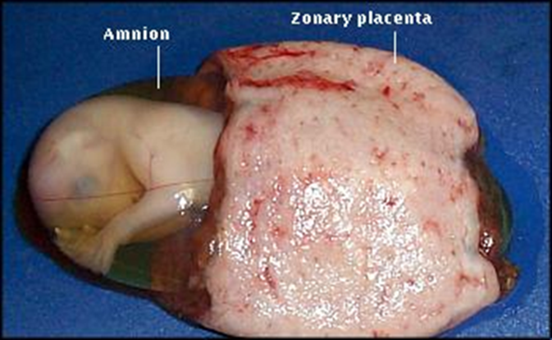

Slide 6
Discoid Placenta (human)

Slide 7
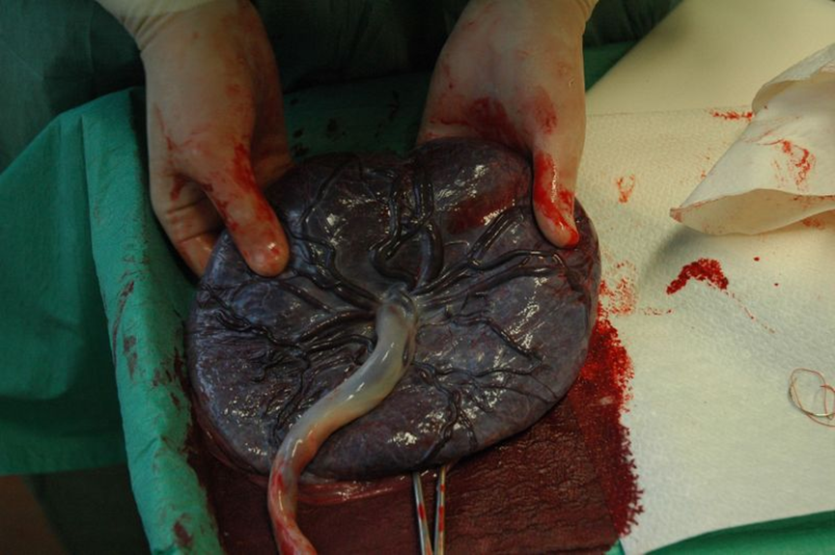

Slide 8
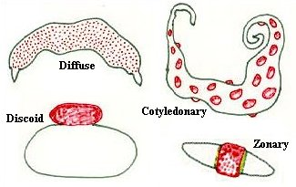

Slide 9
Histological Classification

